Slide 1
EE-357: CCN Introduction to Physical Layer
Hassaan Khaliq Qureshi
School of Electrical Engineering & Computer Science
National University of Sciences & Technology (NUST)
Pakistan.

Slide 2
Typical Communication System
Information source
Information sink
Transmitter
Channel
Receiver

Slide 3
The Components
Transmitter
Receiver
Medium
Carries electromagnetic waves. Can be :
Guided medium
e.g. twisted pair, optical fiber
In this course, the focus is on the
Unguided medium
wireless
e.g. air, water

Slide 4
Bandwidth and Data Rate

Slide 5
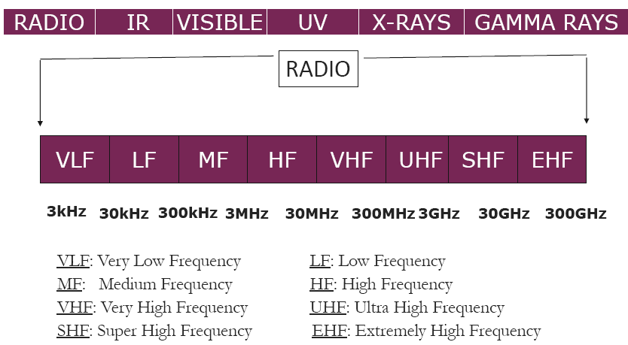
Radio Waves
Image courtesy of Prof. Andrea Goldsmith’s lecture notes
Notes:
Ionizing (or ionising) radiation is radiation composed of particles that individually carry enough kinetic energy to liberate an electron from an atom or molecule, ionizing it.
Ionizing radiation is generated by very high temperature or due to acceleration of charged particles by the electromagnetic fields produced by natural processes. The Ultraviolet to Gamma range is Ionizing.

Slide 6
Radio Waves
Radio waves are characterized by:
Oscillating in time at a frequency, f
Travelling through the air at speed of light, c
Distance covered by one cycle of the wave or wavelength, λ
Wavelength and Frequency are inversely proportional
Notes:
As the frequency is increased the amount of interference caused by the atmosphere reduces...as higher frequency signal has more signal energy in it....so it can penetrate the atmosphere more easily...(the same reason why we use modulation with higher frequency)

Slide 7
Sine Wave – Defining Characteristics
A sine wave is a fundamental periodic signal
Can be represented by three parameters
Peak Amplitude (A)
maximum strength of signal
volts
Frequency (f)
Rate of change of signal
Hertz (Hz) or cycles per second, or times it repeats per second
Mains electricity is 60Hz
Period = time for one repetition (T)
T = 1/f (an inverse relationship)
Phase (φ)
Relative position in time with a single period of the signal
Consider it like this:
Move the Y axis and indicate if its to the left (leading) or right (lagging)
Notes:
the phase, specifies where in its cycle the oscillation begins at t = 0.

Slide 8
Sine Wave – Defining Characteristics
A sine wave is a fundamental periodic signal
Can be represented mathematically as
s(t) = A sin (ωt + φ)
A is amplitude, ω is the angular velocity and φ is the phase
ω is measured in radians per sec.
Engineers tend to prefer to describe this using ‘f’ for frequency, measure in Hz
s(t) = A sin (2πft + φ)
Notes:
An arc of a circle with the same length as the radius of that circle corresponds to an angle of 1 radian. A full circle corresponds to an angle of 2π radians.
Last class question: WiMAX (Worldwide Interoperability for Microwave Access)

Slide 9
Signal Bandwidth versus Channel Bandwidth
A signal is usually made up of sinusoidal signals of varying frequencies
It can be shown (Fourier analysis) that any signal is made up of component sine waves
A given function or signal can be converted between the time and frequency domains with a pair of mathematical operators called a transform.
An example is the Fourier transform, which decomposes a function into the sum of a (potentially infinite) number of sine wave frequency components. The 'spectrum' of frequency components is the frequency domain representation of the signal.
Notes:
A frequency-domain representation can also include information on the phase shift that must be applied to each sinusoid in order to be able to recombine the frequency components to recover the original time signal.
The inverse Fourier transform converts the frequency domain function back to a time function.

Slide 10
Frequency Domain Concept
Why we analyze the signal in the frequency domain?
A frequency-domain graph shows how much of the signal lies within each given frequency band over a range of frequencies.
A given function or signal can be converted between the time and frequency domains with a pair of mathematical operators called a transform.
Hence, we can have an equivalent representation of any signal in the frequency domain
Notes:
Fourier transform for frequency domain and Inverse for time domain.

Slide 11
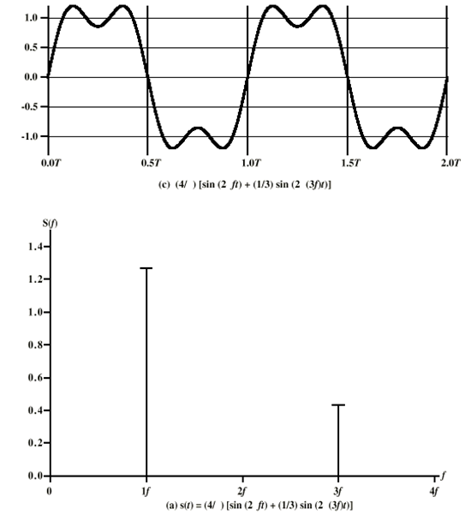
Signal Bandwidth versus Channel Bandwidth
(4/π)*( sin(2π(1f)t) +(1/3)sin (2 π(3f)t) )
Image courtesy of William Stallings’ lecture notes

Slide 12
Signal Bandwidth versus Channel Bandwidth
Can you see how we can represent the following signal in terms of its sinusoidal components?
(4/π)*( sin(2π(1f)t) +(1/3)sin (2 π(3f)t) )
Image courtesy of William Stallings’ lecture notes
Notes:
So Here we see a frequency domain function S(f) that specifies the peak amplitude of the constituent frequencies of the signal s(t)=
(4/π)*( sin(2π(1f)t) +(1/3)sin (2 π(3f)t) )
This means we have a component at f of magnitude 4/π = 1.27 and another at 3f of magnitude 4/π*1/3 = 0.42
Its bandwidth is 3f – 1f = 2f

Slide 13
Signal Bandwidth versus Channel Bandwidth
Difference between maximum and minimum frequency components of a signal is generally referred to as:
Signal bandwidth, information bandwidth, source bandwidth, absolute bandwidth …
Some signals have infinite bandwidth, but still have a narrow effective bandwidth
Narrow band of frequencies containing most of the energy
The bandwidth available on the channel is referred to as:
Channel bandwidth, medium bandwidth, transmission bandwidth, available bandwidth…
Notes:
An infinite-bandwidth white noise signal is a purely theoretical construction

Slide 14
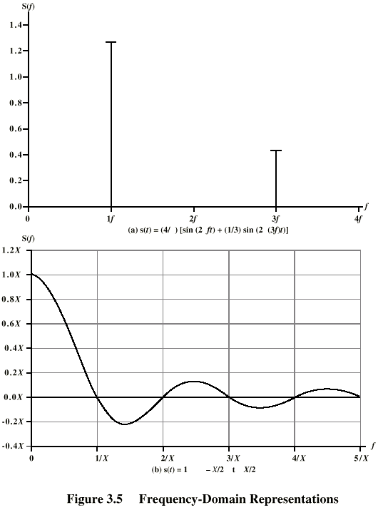
Signal Bandwidth versus Channel Bandwidth
Spectrum
range of frequencies contained in the signal
Here it extends from f to 3f
Absolute bandwidth
width of spectrum
Here its 2f
Effective bandwidth
Often just bandwidth
Narrow band of frequencies containing most of the energy
DC Component
Component of zero frequency
Effective bandwidth
Notes:
When describing a periodic function in the frequency domain, the DC bias, DC component, DC offset, or DC coefficient is the mean value of the waveform. If the mean amplitude is zero, there is no DC offset

Slide 15
Exercise
Lets have an approximation of a square wave with more and more components
a) (4/π)*( sin(2π(1f)t) +(1/3)sin (2 π(3f)t) )
b) (4/π)*( sin(2π(1f)t) +(1/3)sin (2 π(3f)t) +(1/5)sin (2 π(5f)t) )
c) (4/π)*( sin(2π(1f)t) +(1/3)sin (2 π(3f)t) +(1/5)sin (2 π(5f)t) +(1/7)sin (2 π(9f)t) )
a) If we had a signal frequency of 10⁶Hz(1Mhz) these would have bandwidths of
b) If we had a signal frequency of 2*10⁶Hz(2Mhz) these would have bandwidths of

Slide 16
Answer to the Exercise
If we had a signal frequency of 10⁶Hz(1Mhz) these would have bandwidths of
a) Extreme components at 1f and 3f = Bandwidth of 2f = 2 *10⁶ = 2 MHz
b) Extreme components at 1f and 5f = Bandwidth of 4f = 4 *10⁶ = 4MHz
c) 8MHz
If we had a signal frequency of 2*10⁶Hz(2Mhz) these would have bandwidths of
a) Extreme components at 1f and 3f = Bandwidth of 2f = 2 *2*10⁶ = 4 MHz
b) Extreme components at 1f and 5f = Bandwidth of 4f = 4 *2*10⁶ = 8MHz
c) 16MHz

Slide 17
Signal Bandwidth versus Channel Bandwidth
Signal bandwidth should be lesser than the medium bandwidth for the signal to be transmitted accurately
If the signal bandwidth is greater than the medium bandwidth, then some of the signal’s frequency components are truncated during transmission
Generally, the signal is passed through a band limiting filter before modulation

Slide 18
Signal Bandwidth versus Channel Bandwidth
Can you see how we can represent a square wave in terms of its sinusoidal components?

Slide 19
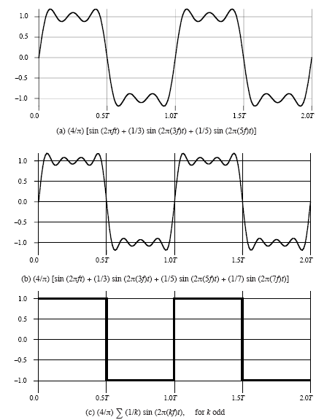
Signal Bandwidth versus Channel Bandwidth
Can you see how we can represent a square wave in terms of its sinusoidal components?
Image courtesy of William Stallings’ lecture notes

Slide 20
Signal Bandwidth versus Channel Bandwidth
As we add more frequency components, the signal becomes more and more exact
But the signal frequency increases and it might not fit in the channel bandwidth
Thus an inherent tradeoff between signal and channel bandwidths exists
Image courtesy of William Stallings’ lecture notes

Slide 21
Signal Bandwidth versus Channel Bandwidth
For a ‘real world’ square wave the more frequency components it has, the better it approximates the ideal signal
You probably want your real signal to be as close as possible to the ideal.

Slide 22
Exercise
Can you draw the frequency domain representation of:
(4/π)*( sin(2πft) +(1/3)sin (2 π(3f)t) +(1/5)sin (2 π(5f)t) +(1/7)sin (2 π(7f)t) )
Steps
Identify all the components
Determine the magnitude of each
Draw graph
Show that its bandwidth is 6f.
Notes:
If a signal has a DC component then it will shift bit further to the level of the DC component.

Slide 23
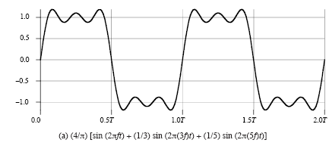
Bandwidth and Data Rate
Consider a transmitter uses the following approximate sine wave to send binary (0,1) symbols
What is the bandwidth of one cycle of this signal?
Image courtesy of William Stallings’ lecture notes

Slide 24
Bandwidth and Data Rate
Consider a transmitter uses the following approximate sine wave to send binary (0,1) symbols
What is the bandwidth of one cycle of this signal?
5-1 = 4 Hz
Image courtesy of William Stallings’ lecture notes

Slide 25
Bandwidth and Data Rate
Signal Bandwidth of one cycle: 5-1 = 4 Hz
If the channel bandwidth is 4MHz, how many cycles of this signal can we transmit in the available bandwidth?
Image courtesy of William Stallings’ lecture notes

Slide 26
Bandwidth and Data Rate
Signal Bandwidth of one cycle: 5-1 = 4 Hz
If the channel bandwidth is 4MHz, how many cycles of this signal (mentioned above) can we transmit?
4 Hz for one cycle
1 million cycles in 4 MHz
Image courtesy of William Stallings’ lecture notes
Notes:
There is a direct relationship between data rate and bandwidth: the higher the data rate of a signal, the greater is its required effective bandwidth.
Although a given waveform may contain frequencies over a very broad range, as a practical matter any transmission system (transmitter plus medium plus receiver) will be able to accommodate only a limited band of frequencies. This, in turn, limits the data rate that can be carried on the transmission medium.
What is the data rate (bits/sec) that we can achieve?
10⁶ cycles ----------- 1 sec
1 cycle ------------- 1µ sec
2 bits ------------- 1µ sec
1 bit -------------- 0.5µ sec
=> Data rate = 2 Mbps can be achieved?

Slide 27
Data Rate and Bandwidth
Any transmission system has a limited band of frequencies which limits the data rate that can be carried
However, the limited bandwidth increases distortion
Therefore, a direct relationship between data rate & bandwidth exists.

Slide 28
Bandwidth and Data Rate
There is a direct relationship between data rate and bandwidth [see next slide]: the higher the data rate of a signal, the greater is its required effective bandwidth and so the channel bandwidth or medium bandwidth
Although a given waveform may contain frequencies over a very broad range, as a practical matter any transmission system (transmitter plus medium plus receiver) will be able to accommodate only a limited band of frequencies.
This, in turn, limits the data rate that can be carried on the transmission medium.

Slide 29
Shannon Equation
The larger the bandwidth the higher the transmission speed
The stronger the signal, the higher the transmission speed
The ‘louder” the noise, the lower the transmission speed
Shannon Equation:
Maximum Data rate = Bandwidth * Log₂ (1 + Signal Power/Noise)
Claude Shannon, A Mathematical Theory of Communication, 1948

Slide 30
Bandwidth and Throughput
Bandwidth and throughput are two of the most confusing terms used in networking; primarily, because it can be defined in various ways.
Bandwidth is literally the width of frequency band; e.g., voice-grade telephone can support frequencies from 300 Hz to 3300 Hz and said to have a bandwidth of 3KHz.

Slide 31
Bandwidth and Throughput
When we talk to bandwidth of a link, we usually refer to the number of bits per second that can be transmitted on the link. We might say that the bandwidth of an Ethernet link is 10 Mbps.
More generally, we tend to use the term throughput to refer to the measured performance of the system. E.g., due to various inefficiencies, a pair of nodes connected by a link of 10 Mbps may achieve a throughput of only 2 Mbps.

Slide 32
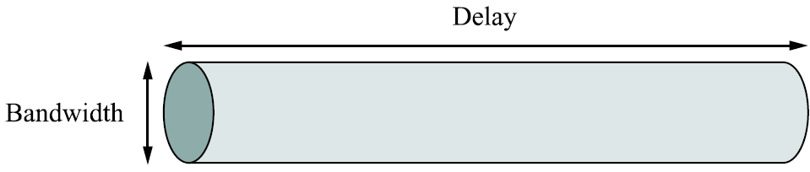
Throughput and bandwidth
The theoretical number of bits that can be sent per second = bandwidth
The measured number of bits that can be successfully sent per second = throughput
Instantaneous and average throughput

Slide 33
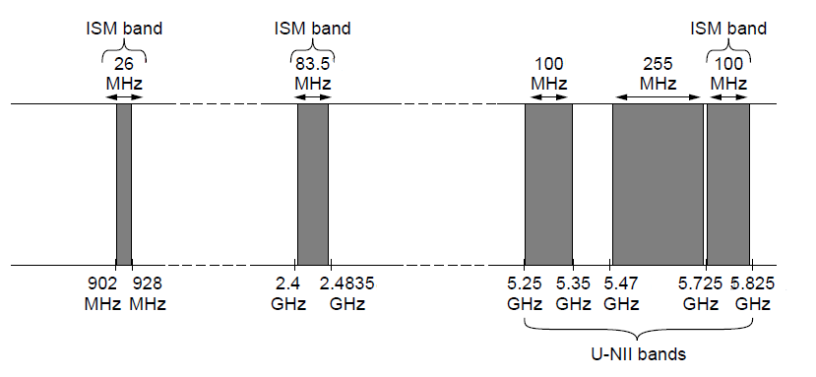
The Politics of the Electromagnetic Spectrum
ISM and U-NII bands used in the United States by wireless devices
Notes:
White Spaces: Frequency bands that have been allocated but are not being used locally.
Unlicensed National information infrastructure

Slide 34
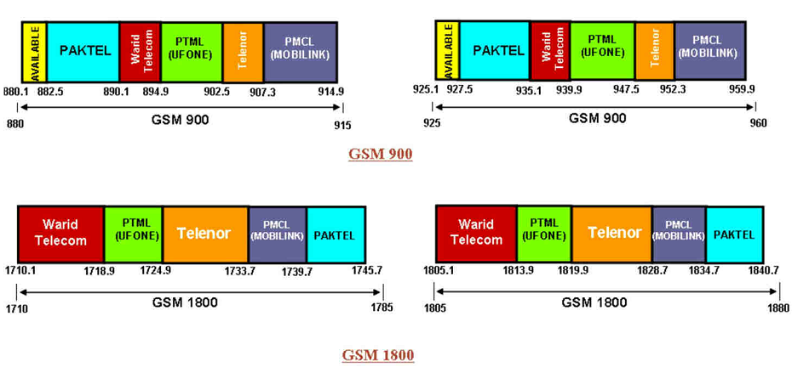
The Politics of the Electromagnetic Spectrum
Notes:
White Spaces: Frequency bands that have been allocated but are not being used locally.
Unlicensed National information infrastructure

